Slide 1
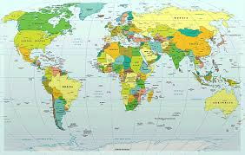

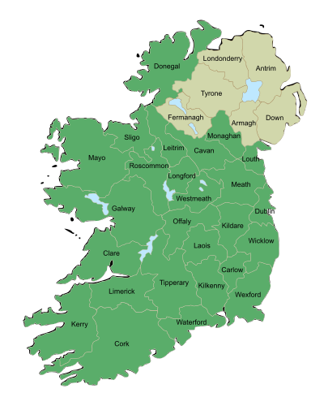
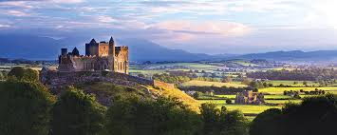
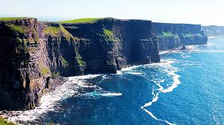
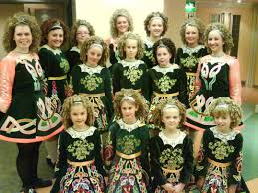
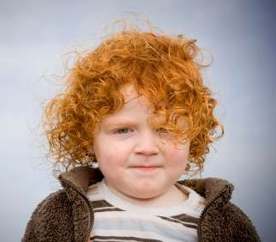
Ireland
Size: 70,273 km²
Population: 4.75 million
Birth rate: 14/1000
Notes:
Ireland is a beautiful country on the Western edge of Europe. It has a land mass and a population slightly smaller than Hokkaido.
Ireland has been an independent Republic since 1922 and joined the European Union in 1973.
Ireland has a fast growing population with twice the birth rate of Japan.
The national immunisation programme is recommended by an independent expert group and is provided free of charge to all children in the State.

Slide 2
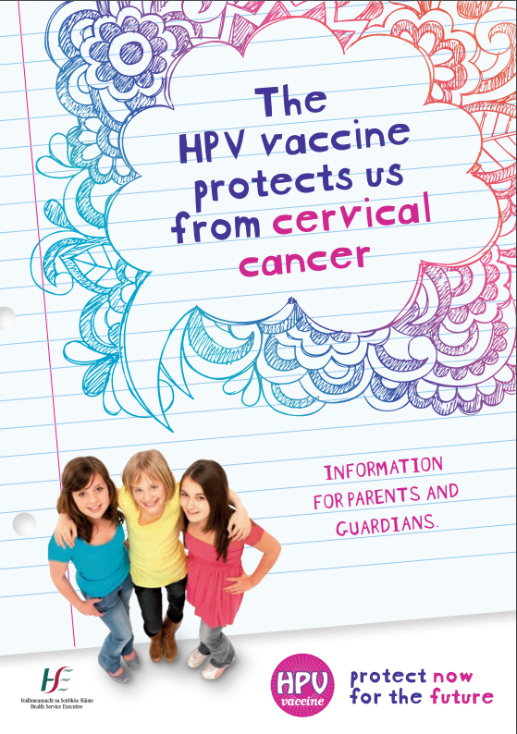
HPV vaccination programme
Recommended by NITAG for 12-13 year old girls
Commenced in 2010
School based programme
  Cohort ~30,000
  1st year of second level school
  September/October and March/April
  Clinics for those who miss out
Notes:
The expert group recommended HPV vaccine should be given to all 12-13 year old girls and the HPV vaccination programme began in Ireland in 2010. The quadrivalent vaccine, Gardasil, manufactured by MSD is used in a school based programme. The school year in Ireland starts in September and finishes in May. Girls are offered the vaccine when they start second level school and initially girls were given a 3 dose course over 6 months and since 2014/15 a two dose schedule has been given. Every year school vaccination teams, which consist of doctors and nurses, visit schools on two occasions to offer the vaccine to an estimated 30,000 girls– at the beginning of the year in September and October and six months later in March/April. Appointments are given to attend local health clinics for girls who miss out on the school visit.
All parents are sent an information pack in advance of the school visit – this consists of an information leaflet and consent form. This information is literacy proofed so it can be easily understood and is available in 11 different languages. Parents are given phone numbers for the vaccination teams if they have any queries and they are also referred to our website www.hpv.ie for more information.

Slide 3
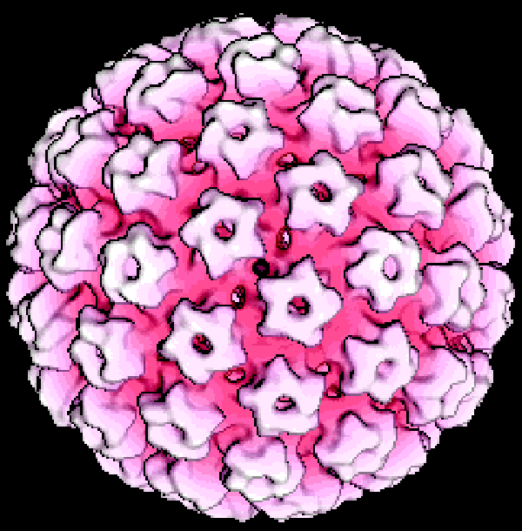
Implementation
HPV4 (Gardasil) procured
Vaccination teams established in all areas
Training programme developed with clinical guidelines
Computerised image of the human papillomavirus
Courtesy of Dept of Pathology, University of Cambridge
www.hpv.ie

Slide 4

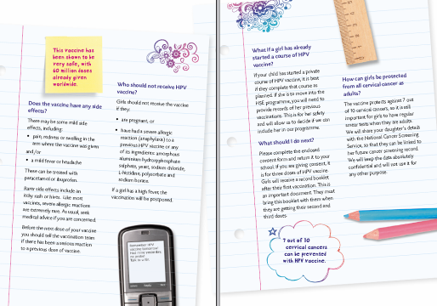
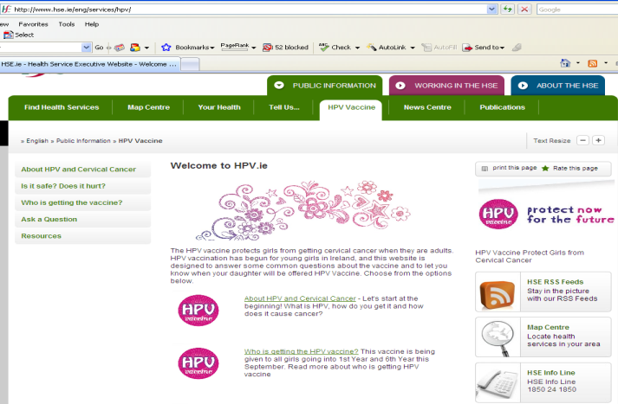
Consultation and website
Parents (over 90% happy with content of materials)
Department of Education
School management bodies
National parents council
Other stakeholders
Media
www.hpv.ie
includes
  Ask a question
  Translated materials
Highlight the importance of cervical screening in the future
www.hpv.ie

Slide 5
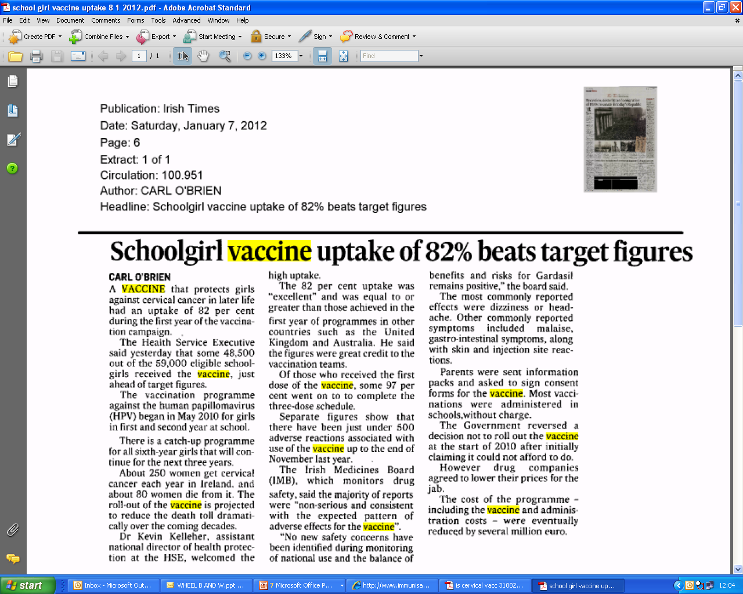
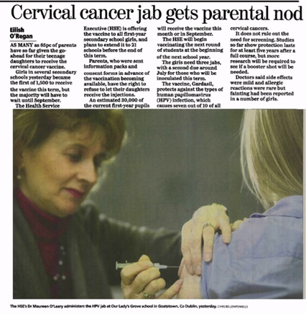
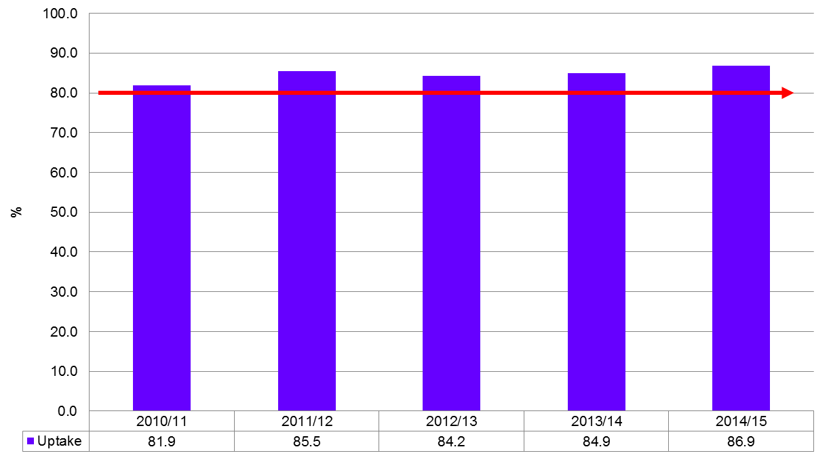
HPV vaccine uptake 2010/11 - 2014/15
Target 80%
Uptake target 80%
Highest uptake achieved in 2014/15
Excellent cohort retention
97% girls who started dose 1 completed the course
Notes:
From the start of the programme the vaccine uptake was very good. Our target was 80% for a full vaccine course and from 2010 – 2014 the uptake always reached the target and increased every year to 87% in 2014/15. The cohort retention was excellent. 97% of girls who started the first dose of vaccine completed the course.

Slide 6
Timeline of Influential Events
Japan suspends vaccine recommendation
Danish TV documentary
American College of Pediatrics
Minister questioned in parliament
Joint Committee on Health & Children
Irish TV documentary
Nov 7
Anti-vaccine leaflet
Dec 20
2013
June
2014
2015
Mar
May
Jun
Jul
Nov
Dec
2016
Jan
Jun
Sept
6 days
Today
EMA review
Go fund me video
18 days
25 days
R.E.G.R.E.T
17 days
High Court Action
25 days
Anti Vaccine Group actions
Anti-vaccine media coverage
www.hpv.ie
Notes:
However in 2014 things began to change – the suspension of the vaccine in Japan followed by the broadcasting of the Danish TV documentary both alleging the vaccine caused serious long term side effects led to vaccine safety concerns in Ireland. In Ireland a group called REGRET was set up in May 2015. REGRET stands for Reactions and Effects of Gardasil Resulting in Extreme Trauma. According to their website “this group was set up by parents of Irish teenage girls who have developed serious health problems after entering secondary school. These parents are certain that the HPV vaccine (Gardasil) is the cause of their daughters' otherwise unexplained illness.” They claim to have up to 400 girls in their group. The group have been excceptionally active in the media and this resulted in a Irish TV documentary shown in December 2015. Their other activities included meetings with politicians, a legal challenge taken by a nurse to have the vaccine withdrawn which was eventually dismissed, the distribution of anti vaccine leaflets to schools, outside schools with regular anti vaccine social, local and national media coverage.

Slide 7
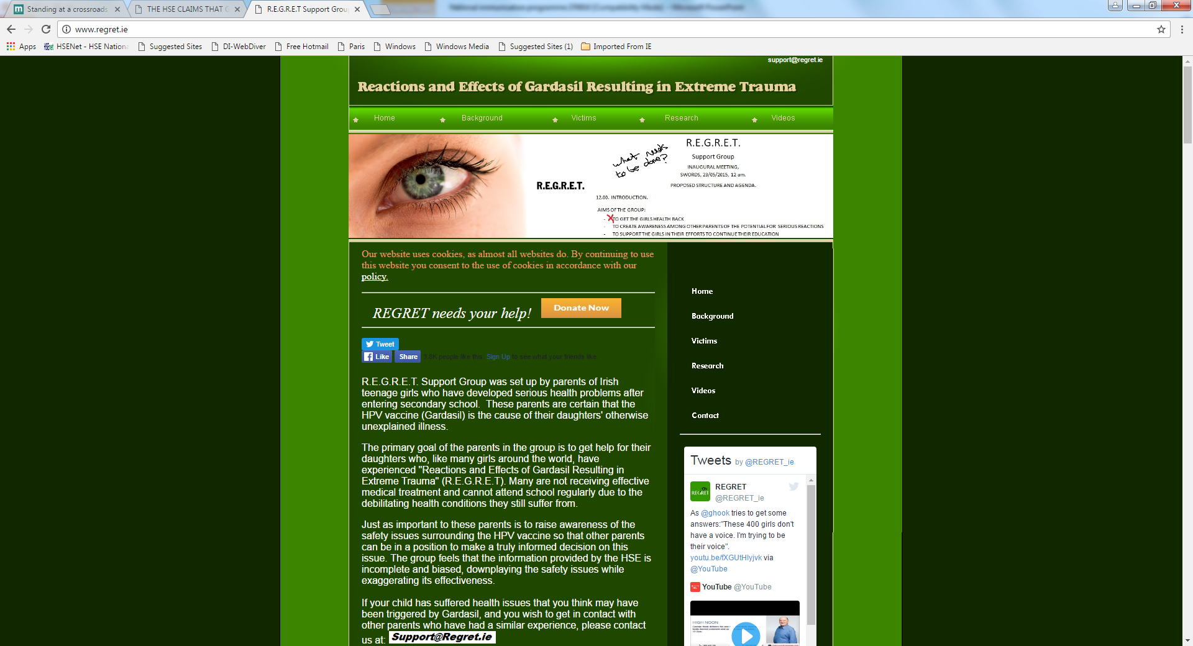
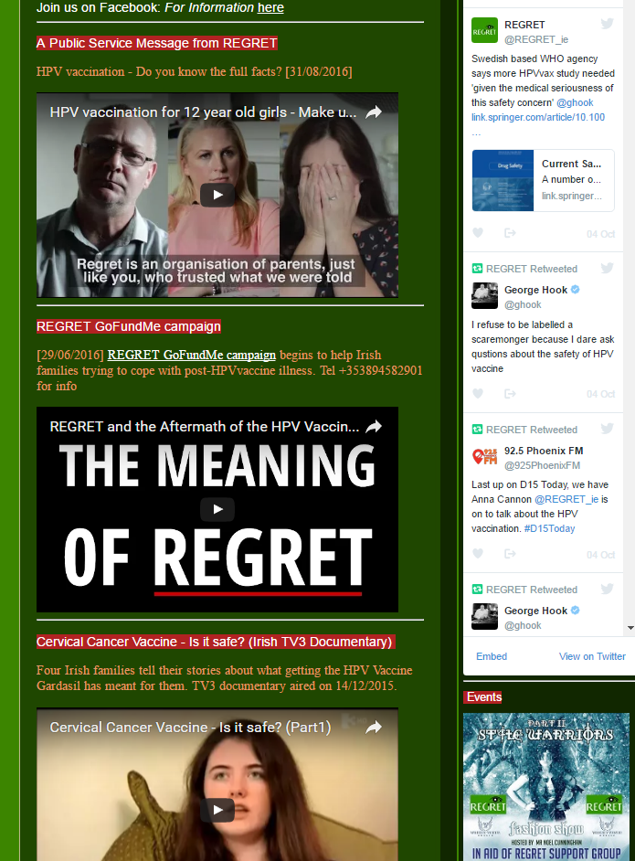
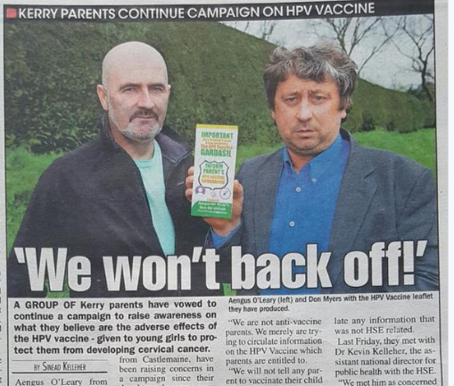
Notes:
This slide shows you some examples of the media coverage – the website from REGRET is extremely emotive and has many youtube videos from girls telling how they have prolonged fatigue and other symptoms and how the vaccine has destroyed their lives. These have all had tens of thousands of hits. Another group was also established called Inform Parents – these two men, one of whom is a former president of the national parents council, produce glossy leaflets outlining all the side effects they say the vaccine causes. The two groups targeted schools when they knew the school teams would be visiting and local radio shows had interviews with parents and their daughters from the groups on the morning of the vaccinations.

Slide 8
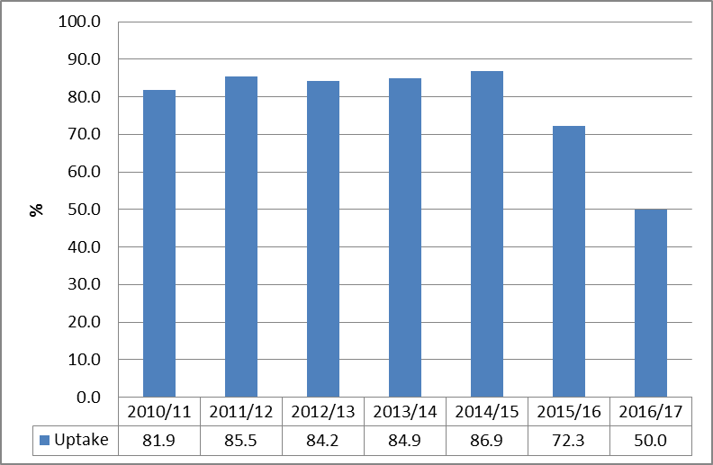
HPV vaccine uptake 2010/2011 - 2016/2017
Estimated
uptake
1st dose
Target 80%
15,000 girls not vaccinated in 2016/17
www.hpv.ie
Notes:
The results of all this anti vaccine coverage can be seen in this slide. Our excellent HPV vaccine uptake dropped to 72% in 2015/16 and in 2016/17 we estimate only 50% girls received the first dose. This meant that 15,000 girls were not vaccinated.

Slide 9
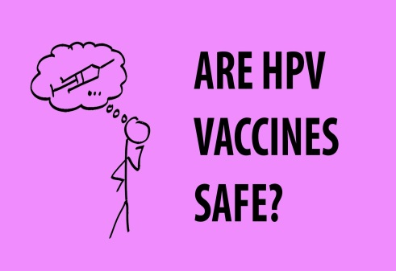
Parental Concerns
Vaccine safety
Vaccine safety
Vaccine safety
Vaccine causes serious side effects
Lack of information
Consent process too rushed
Health services linked to vaccine manufacturer
Notes:
Why were parents refusing the vaccine for their daughters? The key issue is vaccine safety – is this vaccine safe, will my daughter be harmed? I have heard the vaccine causes many serious side effects. I don’t want my daughter ending up in a wheelchair – these concerns were much more real and immediate than any thoughts of the harm from cervical cancer. Other issues were the lack of information – that we were not telling them about all the side effects caused by the vaccine, that the consent process was too rushed – they only receive the information pack and had to return within a few days, that the health services are in the pocket of the vaccine manufacturer who is making large profits and a general anti establishment agenda that has been seen in many neighbouring countries in recent times.

Slide 10



Actions
Liaison
The Irish Cancer Society
National Cancer Control Programme
Cancer research centre
Consistent messages re
  cervical cancer morbidity and mortality
  vaccine safety and efficacy

Slide 11
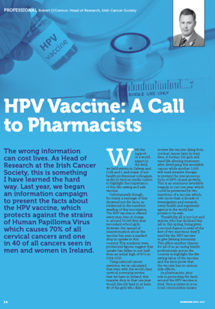

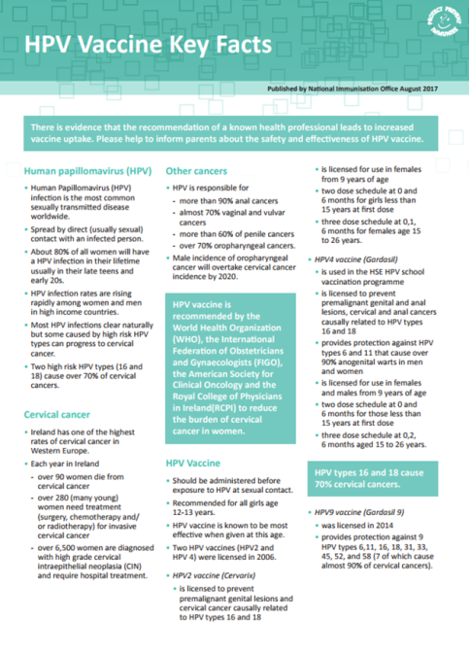

Actions
Health professional training
Regional immunisation updates
Primary care e-learning modules
Health professional meetings
Pharmacies
Fact sheets/ articles in journals

Slide 12
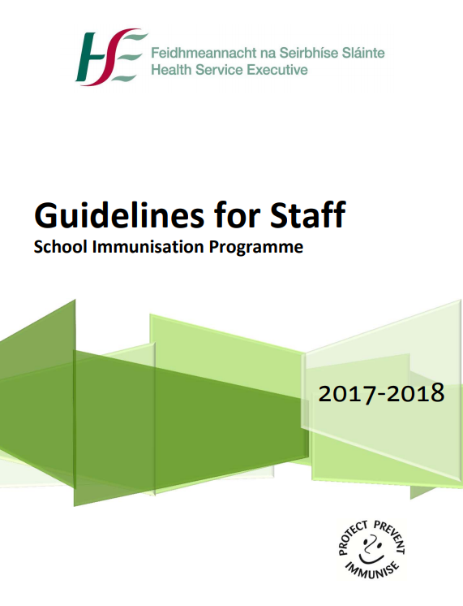
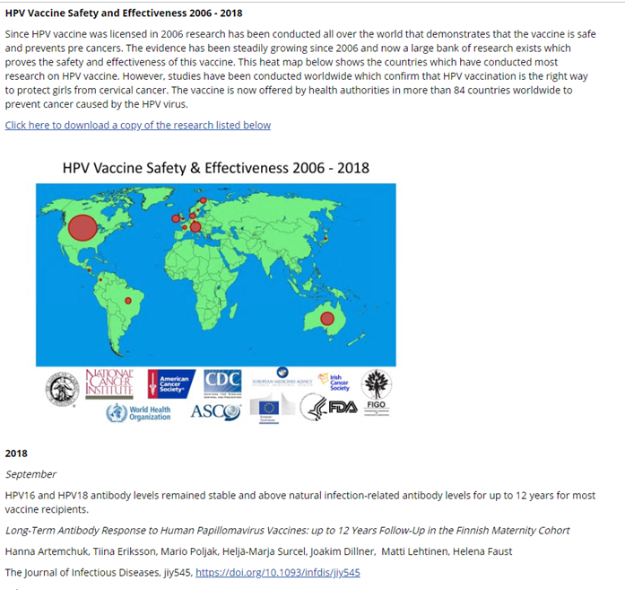
Support for vaccination teams
Updated guidelines
Frequently asked questions
Regular teleconferences
Frequent updates by email and to website
National conferences May 2017 and 2018
www.hpv.ie

Slide 13
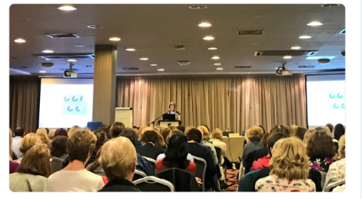
May 2017 conference
Participants asked
  for their views on how to improve uptake
  to ask vaccinated girls to take part in social media campaign
“A very much needed information day. Very informative & gives me confidence answering questions from parents.”
“Great conference. A real confidence builder for those working on the ground because it’s been a tough year with lots of stress”.
www.hpv.ie

Slide 14
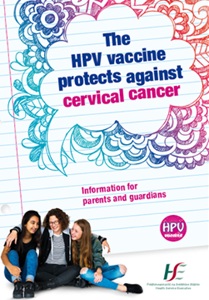
Actions
Audit of information leaflets in countries with high vaccine uptakes in school based programmes
Revise information leaflet for parents
Information materials to parents at start of school year (late August)
Delay start of 1st dose vaccines to mid September to allow parents time to consider vaccination
Offer vaccine to older unvaccinated girls
www.hpv.ie

Slide 15


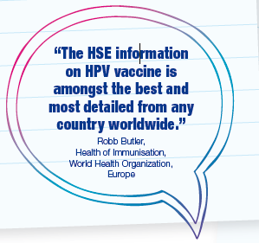

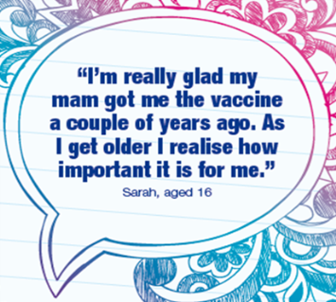
Actions
Information for parents
Focus groups
Offer vaccine again and again
Information for parents of 11-12 year old girls
Revised parents leaflet (with quotes)
More time to consent

Slide 16
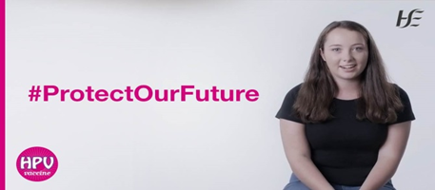
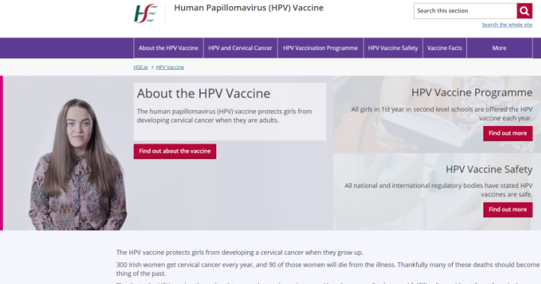
Actions
Information for parents
Website redesigned
Short information videos
national and international experts
vaccinated girls and their parents

Slide 17
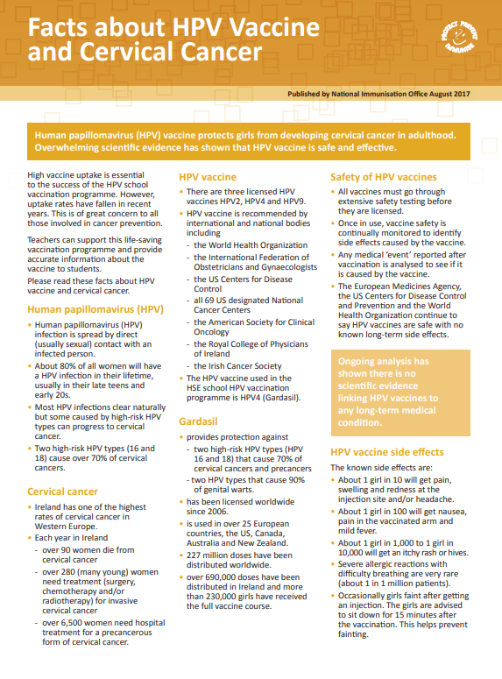
Actions
Liaison
Department of Education
Post primary and primary
    School management bodies
    Principals’ associations
    Teachers’ unions
    National Parents Councils
    Science Teachers Association

Slide 18
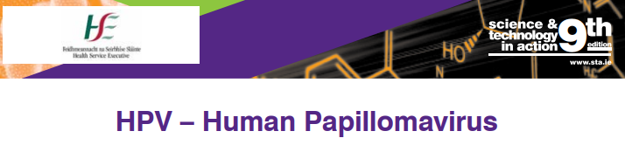
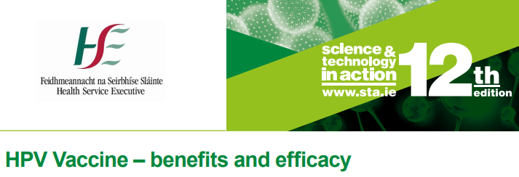
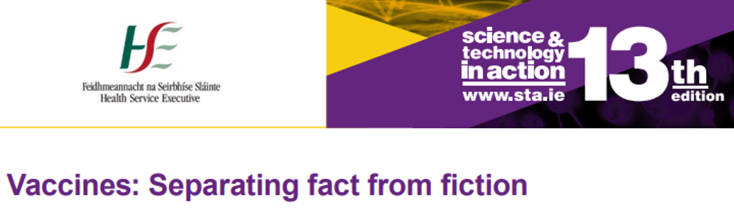
Building for the future
2013
Lesson plans
for
15-18 year olds
2016
2017
www.hpv.ie

Slide 19
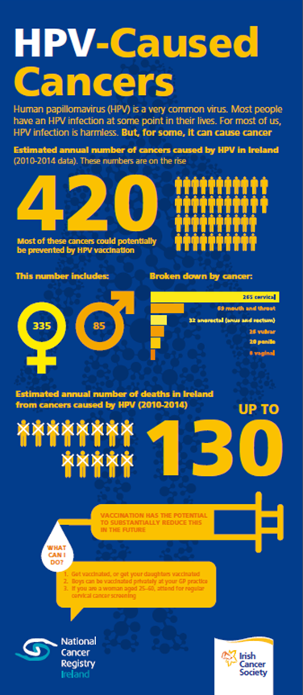
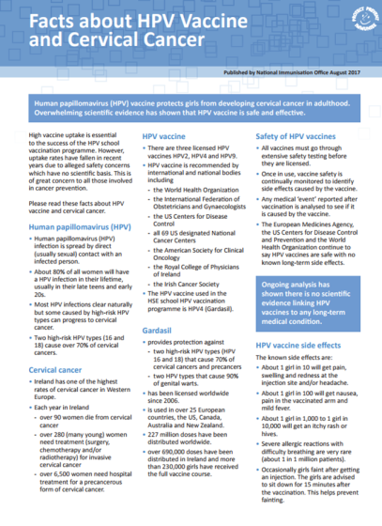
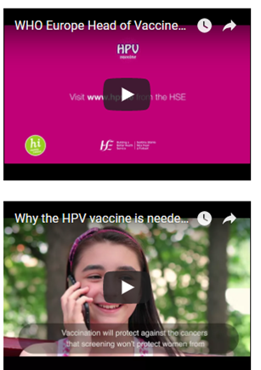
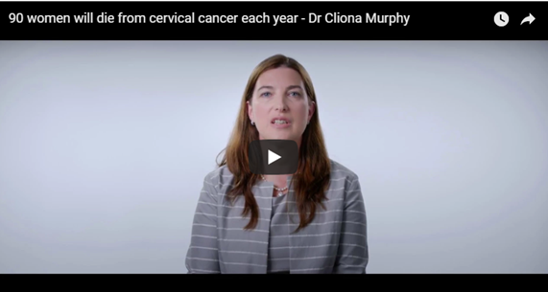
Actions
Increase awareness of vaccine
National and local radio advertising
Social media listening
Social media campaign
  vaccinated girls
  international experts

Slide 20

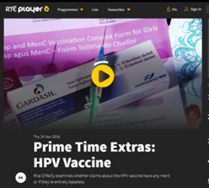
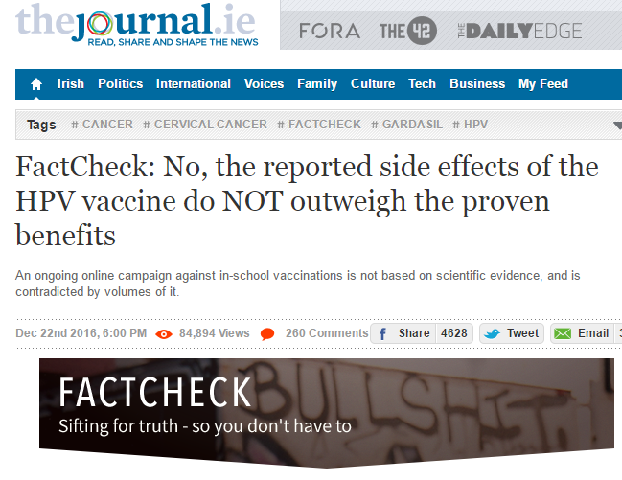
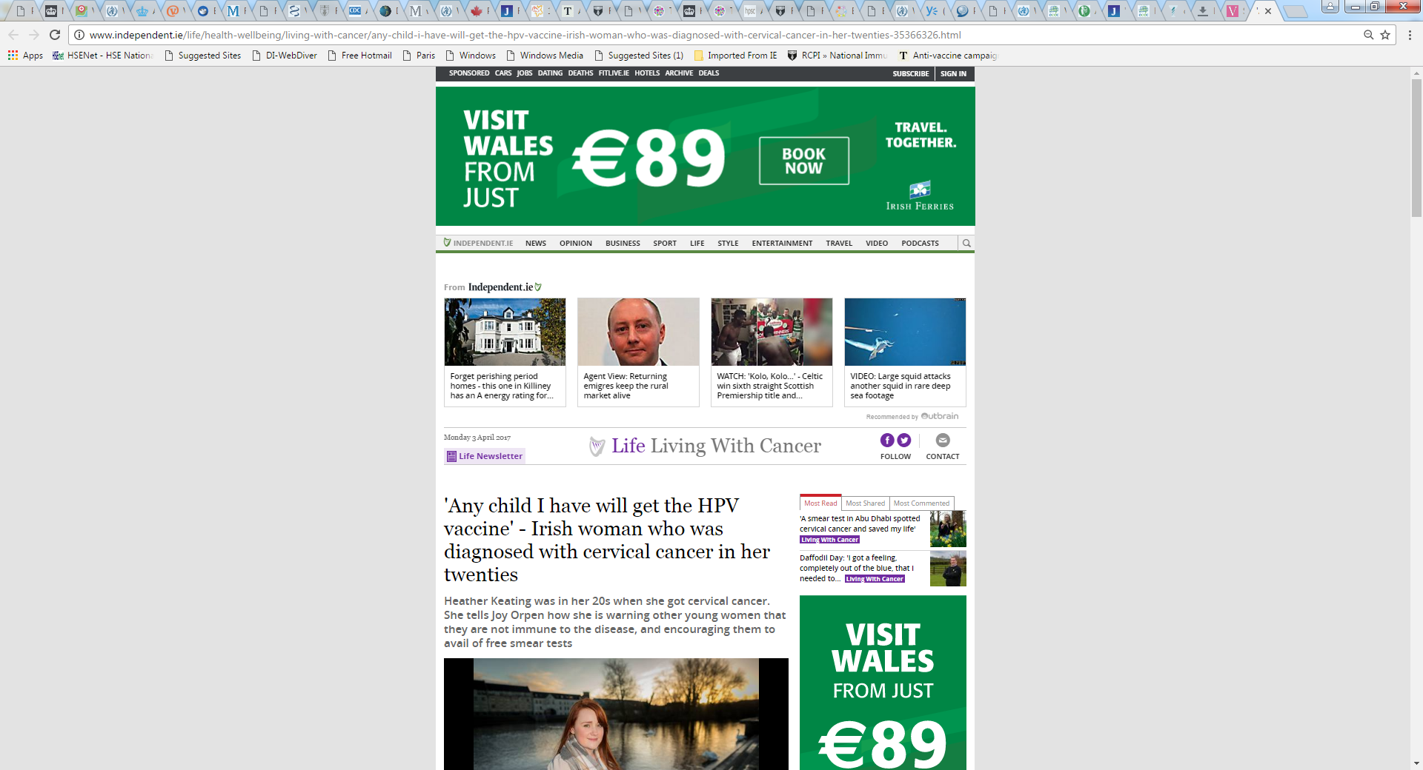
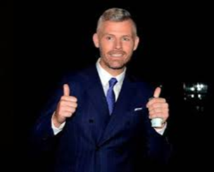
Actions
Better national
and media coverage
Investigative TV
Comedy
TV
Notes:
We ran a social media campaign from February this year and also actively targeted national media. This has led to better coverage including an investigative TV programme concluding the vaccine is safe and more positive articles about the vaccine. One unexpected TV show was very influential – a comedian took on the anti vaccine groups - this show is watched by many more than watch the other serious TV show and this led to much positive media coverage.

Slide 21
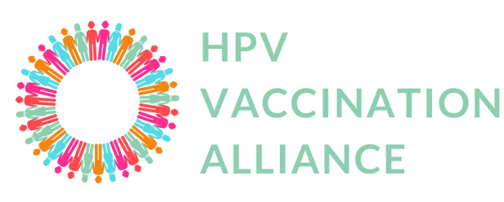
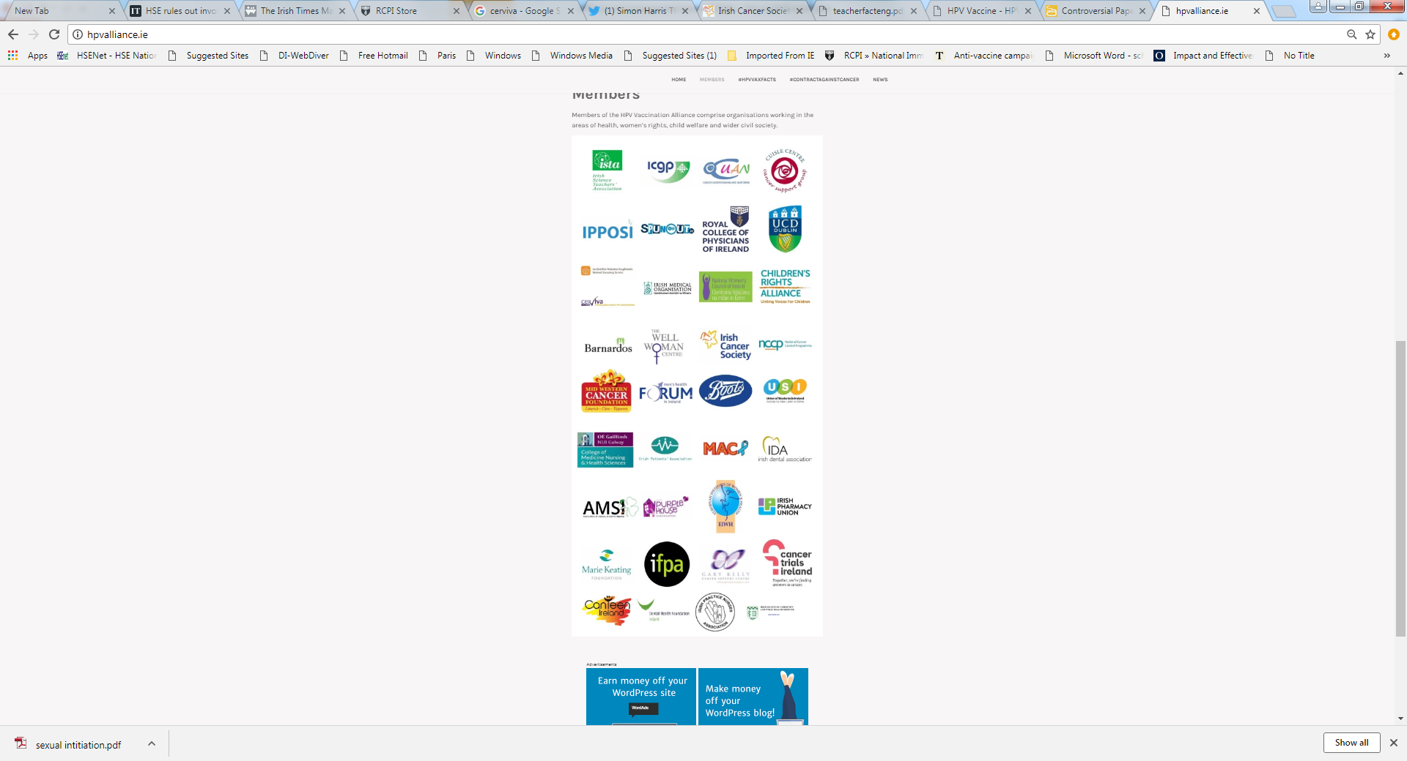
Actions
Alliance of health care and other supportive bodies
Health professional bodies
Children’s Rights Alliance
National Women’s Council
Cancer charities

Slide 22

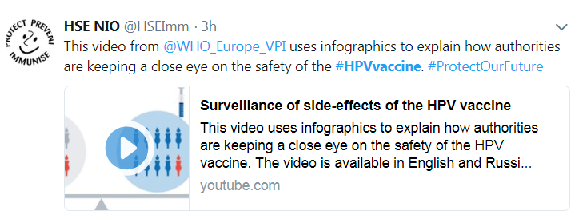
Global
WHO Europe
Peer support network
Regular contact – teleconferences and meetings
Media training
Close links with colleagues in
Japan
Australia
New Zealand
www.hpv.ie

Slide 23
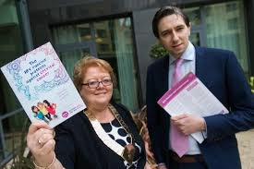
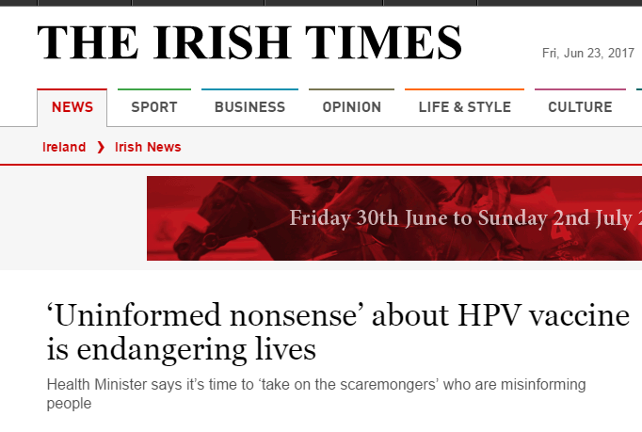
Political support
Minister for Health (age 31)
Very supportive
“If you want to give medical advice on vaccinations, become a doctor. If not, get out of the way and stay away from our public health policy.”
Notes:
We have had very positive political support from all the health representatives of the political parties.
Our Minister for Health who is only 30 years of age spoke at our national HPV conference to show solidarity with the vaccination teams.
He has made very strong statements promoting the vaccine and countering misinformation such as “Uniformed nonsense about HPV vaccine is endangering lives” and
“If you want to give medical advice on vaccinations, become a doctor. If not, get out of the way and stay away from our public health policy.”
The photo shows the Minister with the Chair of the Irish Medical Organisation.
So is there any impact from all these actions?

Slide 24
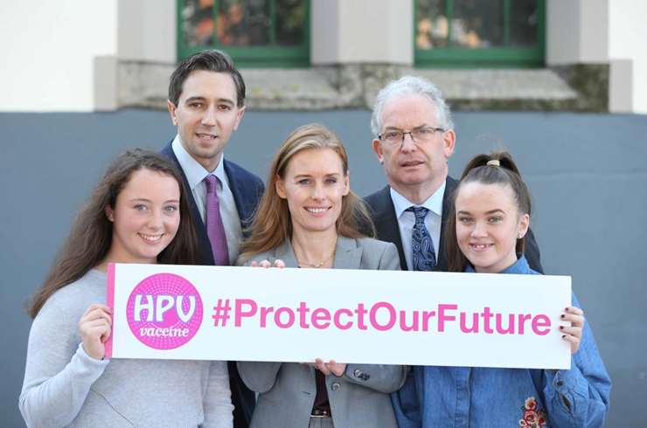
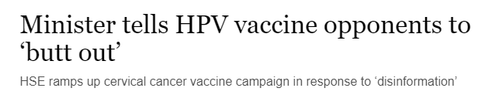
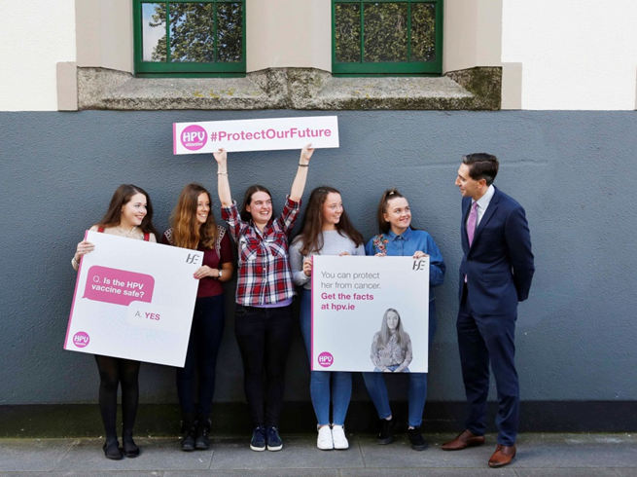
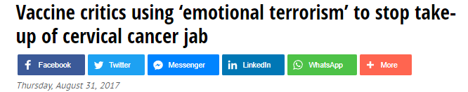
2017/18 campaign launch

Slide 25
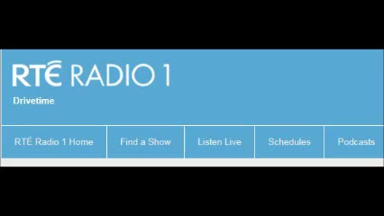
Radio interview with the Minister for Health August 2017
www.hpv.ie

Slide 26

Impact
December 2017
Increase in uptake in 2016/17
Increase in 1st dose uptake in 2017/18
* provisional data

Slide 27


Launch March 2018
www.hpv.ie

Slide 28





www.hpv.ie

Slide 29



Launch 2018/19
www.hpv.ie

Slide 30

Promotional video from the Minister for Health
www.hpv.ie

Slide 31


25 May 2018
www.hpv.ie

Slide 32
Impact
September 2018
* provisional data
www.hpv.ie

Slide 33


Lessons learned
Monitor and listen to the concerns
Collaboration
Support for vaccination teams
Consistency
www.hpv.ie

